Slide 1

Singular Database Design

Slide 2
Quick Question
Why is the Singular Database Design Course the first course on our training?
The key to success is in the foundation of the database's design. Relationships of data must be accurately assessed and once this connection is established, the rest falls into place rather smoothly.
Data Integrity
Eliminate duplicated data
Our starting point when developing custom software for a client (during JAD Sessions)
Singular Object Generator – Generates objects from Tables (and scripts) using wizardry (covered in later courses)

Slide 3



In other words the reason is
If you start from the bottom, you get a solid foundation to build on
The Drake Approach
“Started from the bottom now we’re here”

Slide 4
SQL Default Databases
Creating a Database
Naming Conventions
Primary Key Consideration
Varchar Columns
Bit Columns
Int Columns
Date And Time Columns
Decimal Columns

Slide 5
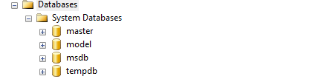
Default SQL Databases
System database | Description
master Database | Records all the system-level information for an instance of SQL Server. Also Logons, list all of all other databases and Initialisation information. SQL cannot start if Unavailable
msdb Database | Is used by SQL Server Agent for scheduling alerts and jobs.
model Database | Is used as the template for all databases created on the instance of SQL Server. Modifications made to the model database, such as database size, collation, recovery model, and other database options, are applied to any databases created afterward. example ARITHABORT
tempdb Database | Is a workspace for holding temporary objects or intermediate result sets.

Slide 6
The master database records all the system-level information for a SQL Server system. This includes instance-wide metadata such as logon accounts, endpoints, linked servers, and system configuration settings.
The msdb database is used by SQL Server Agent for scheduling alerts and jobs and by other features such Database Mail.
The model database is used as the template for all databases created on an instance of SQL Server
The tempdb system database is a global resource that is available to all users connected to the instance of SQL Server and is used to hold the following:
Temporary user objects that are explicitly created, such as: global or local temporary tables
Internal objects that are created by the SQL Server Database Engine
Row versions that are generated by data modification
In production environments it is recommended that you keep an up to date backup of the Master and MSDB databases.

Slide 7
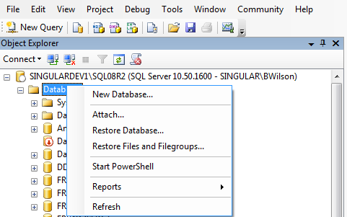
Creating a Database

Slide 8
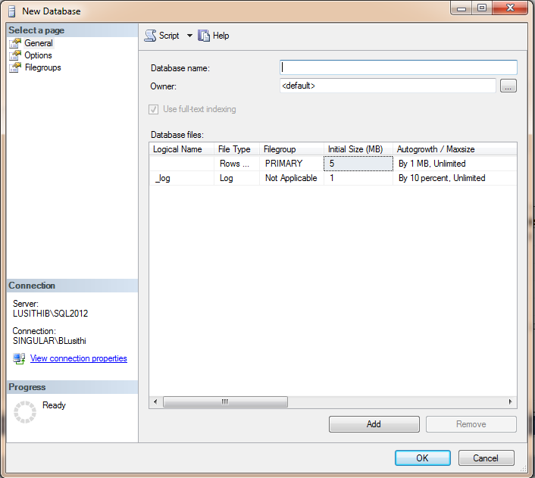

Slide 9
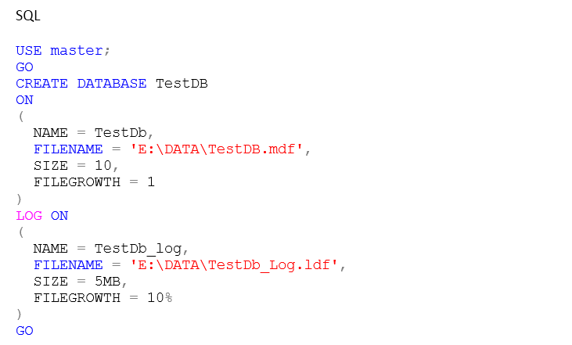
Creating a DB Continued..

Slide 10
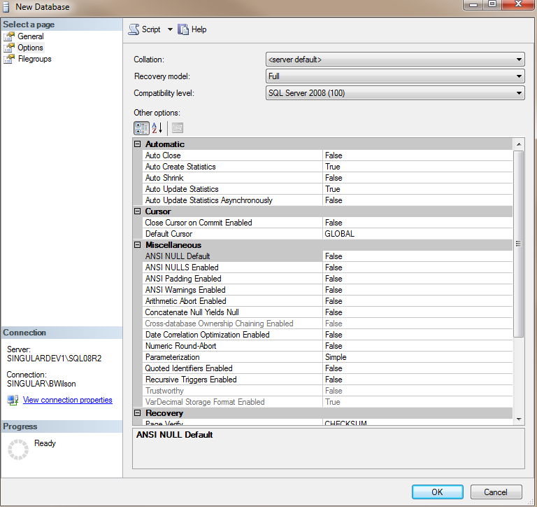
Recovery Model
Very important to have this set to Full for databases that contain important client information. Together with a log backup it can be used to restore to the point of failure if your log can be backed up. Simple uses a lot less log space, can only be restored to the last backup.

Slide 11
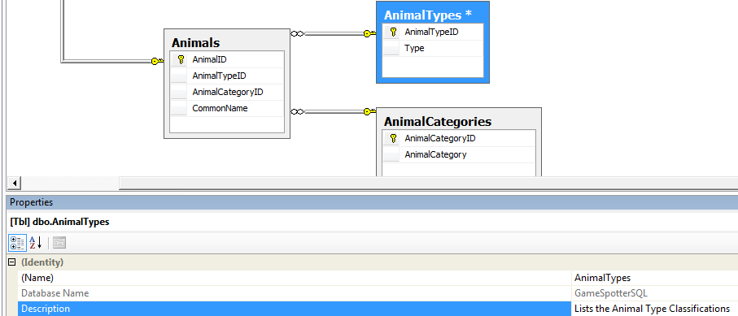
Naming Conventions
Table Name
Give the table a meaningful name. Try to avoid abbreviations.
The table’s name should always be plural since it holds many records (except for a table like SystemConfiguration, which will only ever hold one record)
Specify descriptions for the tables that you create, so that you will always know what the table is used for
There are two ways to specify table descriptions.
You can either do this through the diagram tool, by pressing F4 and writing in the Description.

Slide 12
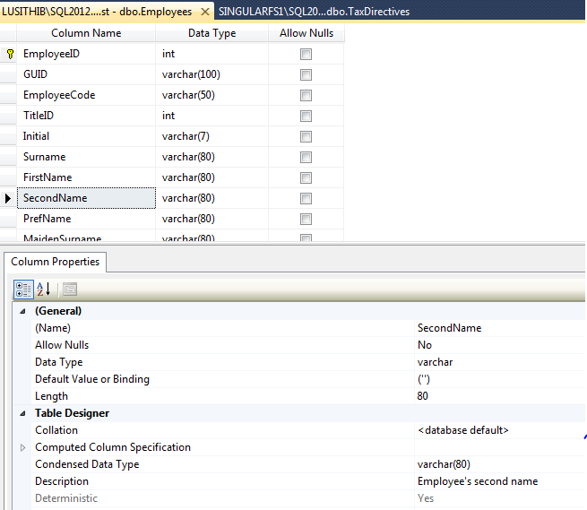
Naming Conventions Continued…
Or you can right click the table, click Design, select the field you want to add a Description to on the Custom Properties.

Slide 13
Table Design
Primary Key Considerations
Use Integer (number) data types as primary key
Make the the primary key the first column and it must be an identity column
Primary Key must be named as the singular (i.e. not plural) of the table name with ‘ID’ appended to it (Table: ‘Details’; PK: ‘DetailID’)
Composite unique indexes can be used in the cases where the combination of multiple columns needs to be unique
Use capital letters where appropriate. Eg. ‘StockDetailID’ and NOT ‘STOCKDetailId’
Put relationships on Primary keys only
Use relationships where necessary.
Put meaningful descriptions on all columns. Eg. StockCount: The amount of stock left in the warehouse. : Count of stock.
The description on foreign key columns should be. Link to <entity> (where <entity> is the singular (not plural) form of the table name.
For auditing information we add CreatedBy (which is an integer linked to the UserID in the system), CreatedDateTime (which is the record creation datetime stamp), ModifiedBy (which is the UserID who modified the record) and ModifiedDateTime (which is the record modification timestamp).

Slide 14
Table Design Continued…
VarChar Columns
A VarChar column must NEVER allow nulls.. Set a default constraint to initialise the column.
If the column is required add a constraint of “len([ColumnName]) > 0”.
Only use VarChar(n) column type(not nvarchar is Unicode and takes up more space).
Bit columns
Should not allow nulls and a default value should be set for simple Boolean comparison
With non-nullable columns, set the default constraint to either 0 or 1.
In the cases where a Tri-state field is used, a bit field can be used which allows nulls. The three states will then be NULL, False (0) and True (1)
Int columns
Nulls should generally only be used on foreign key columns.
If the column does not allow nulls and the default should be to something meaningful for the column.

Slide 15
Table Design Continued…
Date and DateTime Columns
Do not allow nulls on dates that are important to the data such as Transaction dates, only use nulls to signify that the value has never been set. I.e. for Employees all active employees would have a ResignationDate set to null, whereas a EmploymentDate would not be null
For dates that have no time components, name them XDate, for dates with time components name them XDateTime. The datetime field in SQL 2005 and below stores time components. SQL 2008 onwards has the Date data type that does not store time.
For auditing information such as CreatedDateTime, set the default of the column to GETDATE()
Decimal / Money
Column type depends on the amount of precision needed for data to be stored. For currency information, use Money. For percentages use decimal(18-n, n) (where n is the precision required)
Do not allow NULLs, they make data comparison more complicated.
Where Columns are not null, make sure that you specify default constraints.
Add in as many Check Constraints as is necessary.

